Slide 1

Statistics – Probability Distribution
By Saravanan durai.

Slide 2
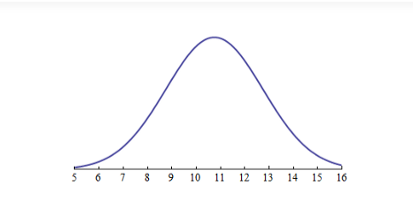
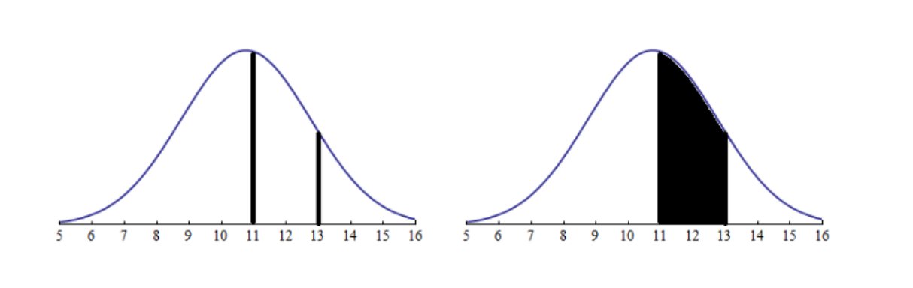
Probability is the measure of the likelihood that an event will occur.,
Let us say we have a normal distribution graph of the average marks of students in a surprise test. (this concept will apply to all continuous distributions)
- Probability and Likelihood.
here, 5/16 is the lowest marks scored and 16/16 is the highest.
Now, the probability that a randomly selected student will have marks between 11–13 marks is the area under the curve between those 2 points
P(marks between 11 and 13 marks
| mean=11 and std = 3) = 0.31

Slide 3
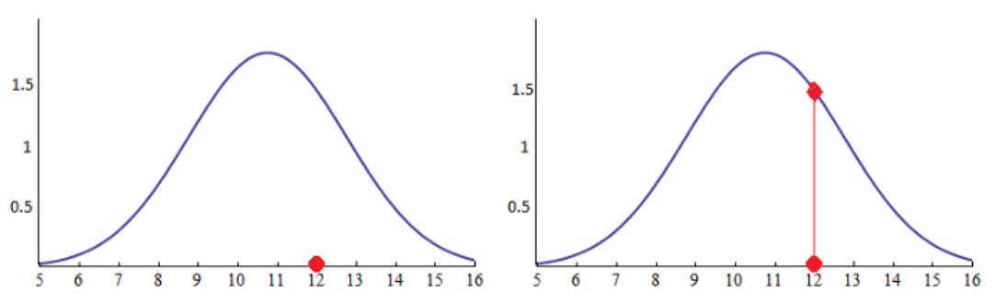
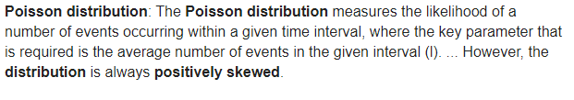
According to Wikipedia, a likelihood function (often simply a likelihood) is a function of parameters within the parameter space that describes the probability of obtaining the observed data.
we choose a student whose marks we already know. Say, we choose a student who scored 12 marks.
L(mean=11 and std = 3
| student scored 12 marks) = 1.48
so, 1.48 is the probability of obtaining the student scoring 12 marks within this parameter space.
Only the distribution changes not the data…
- Probability and Likelihood.

Slide 4
Summary
Probabilities are the areas under fixed distribution
P(data|distribution)
Likelihoods are the y-axis values for fixed data points with distributions that can be moved.
L(distribution| data)
Finally, Probability quantifies anticipation (of outcome), likelihood quantifies trust (in the model).
Bibliography :
https://medium.com/@abhinav.mahapatra10/probability-vs-likelihood-bab5b2b42150
https://stats.stackexchange.com/questions/2641/what-is-the-difference-between-likelihood-and-probability, https://stats.stackexchange.com/questions/2641/what-is-the-difference-between-likelihood-and-probability, https://towardsdatascience.com/probability-concepts-explained-maximum-likelihood-estimation-c7b4342fdbb1, https://www.youtube.com/watch?v=pYxNSUDSFH4

Slide 5
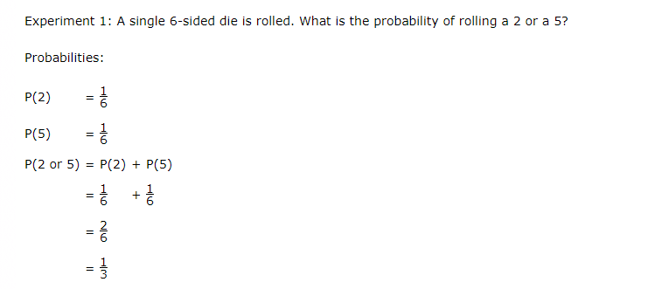
Computing Probability (Addition rule)
Probability of the Union of two events can be found with the addition Rule
AUB = n(A) + n(B) - n(A ∩ B)
For Mutually Exclusive then AUB = n(A) + n(B) - n(A ∩ B)
n(A ∩ B) = 0 ;

Slide 6
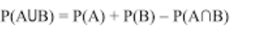
Computing Probability (Addition rule)
Probability of the Union of two events can be found with the addition Rule
For Mutually Exclusive then AUB = n(A) + n(B) - n(A ∩ B)
n(A ∩ B) = 0 ;

Slide 7
Dependent Event & Independent Events
What is a Dependent Event?
When two events are dependent events, one event influences the probability of another event. A dependent event is an event that relies on another event to happen first. Dependent events in probability are no different from dependent events in real life: If you want to attend a concert, it might depend on whether you get overtime at work; if you want to visit family out of the country next month, it depends on whether or not you can get a passport in time. More formally, we say that when two events are dependent, the occurrence of one event influences the probability of another event.
What is an Independent Event?
An independent event is an event that has no connection to another event’s chances of happening (or not happening). In other words, the event has no effect on the probability of another event occurring. Independent events in probability are no different from independent events in real life. Where you work has no effect on what color car you drive. Buying a lottery ticket has no effect on having a child with blue eyes.
When two events are independent, one event does not influence the probability of another event.

Slide 8
Dependent Event & Independent Events
Scenario | Dependent / Independent
Owning a dog and growing your own herb garden.
Winning the lottery and running out of milk.
Robbing a bank and going to jail.
Driving a car and getting in a traffic accident.
Buying a lottery ticket and finding a penny on the floor (your odds of finding a penny does not depend on you buying a lottery ticket).
Boarding a plane first and finding a good seat.
Parking illegally and getting a parking ticket. Parking illegally increases your odds of getting a ticket.
Taking a cab home and finding your favorite movie on cable.

Slide 9
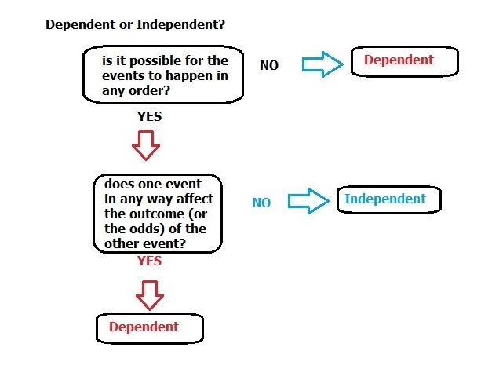
Dependent / Independent
Events : Conculsion

Slide 10
Multiplication Rule
The Multiplication Rule of Probability means to find the probability of the intersection of two events, multiply the two probabilities.
When you want to know the probability of two events occurring, that is called the intersection of the two events. The Multiplication Rule of Probability is used to find the intersection of two different sets of events, called independent and dependent events. Independent events are when the probability of an event is not affected by a previous event. A dependent event is when one event influences the outcome of another event in a probability scenario. To find the intersection of two events, whether they are independent or dependent, multiply the two probabilities together.

Slide 11
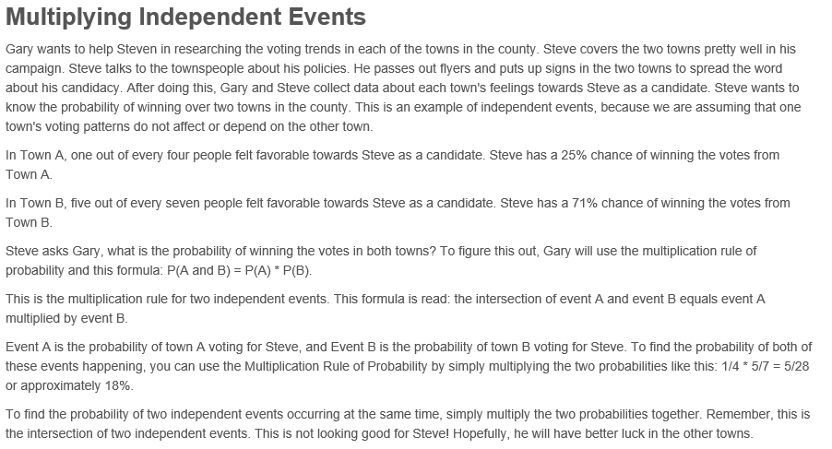

Slide 12
Dependent Events – Multiplication
Gary and Steve are putting together campaign buttons for a rally they are both hosting in a few days. There are 30 buttons total, 13 buttons are blue and 17 buttons are red. Gary puts all of the buttons into a bag. Steve and Gary both want to wear red buttons to the rally. What is the probability that Gary will pull two red buttons in a row out of the bag without looking?
There are 30 buttons total, 13 buttons are blue and 17 buttons are red. What is the probability that Gary will pull two red buttons in a row out of the bag without looking? The first time Gary pulls a button out he has the probability of 17/30, or approximately 57%. The numerator in this probability exercise is 17, the total number of red buttons. The denominator in this probability exercise is 30, the total number of buttons.
If he does not put this button back in to the bag, then the second probability of Gary pulling a red button from the bag is 16/29, or approximately 55%. The numerator in this probability exercise is 16, the total number of red buttons remaining in the bag. The denominator in this probability exercise is 29, the total number of buttons remaining. To find the intersection of these two events using the multiplication rule of probability, simply multiply the two probabilities together: 17/30 * 16/29 = .308 or approximately 31%.

Slide 13
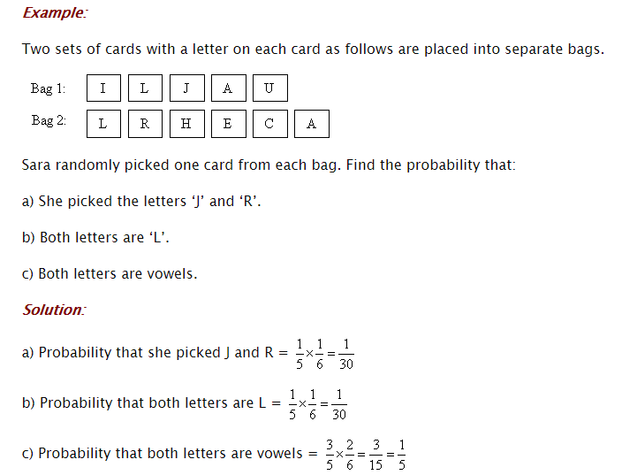
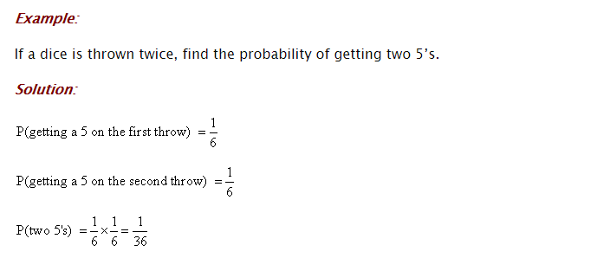
Computing Probability (Multiplication rule)
Notes:
https://www.mathgoodies.com/lessons/vol6/independent_events

Slide 14
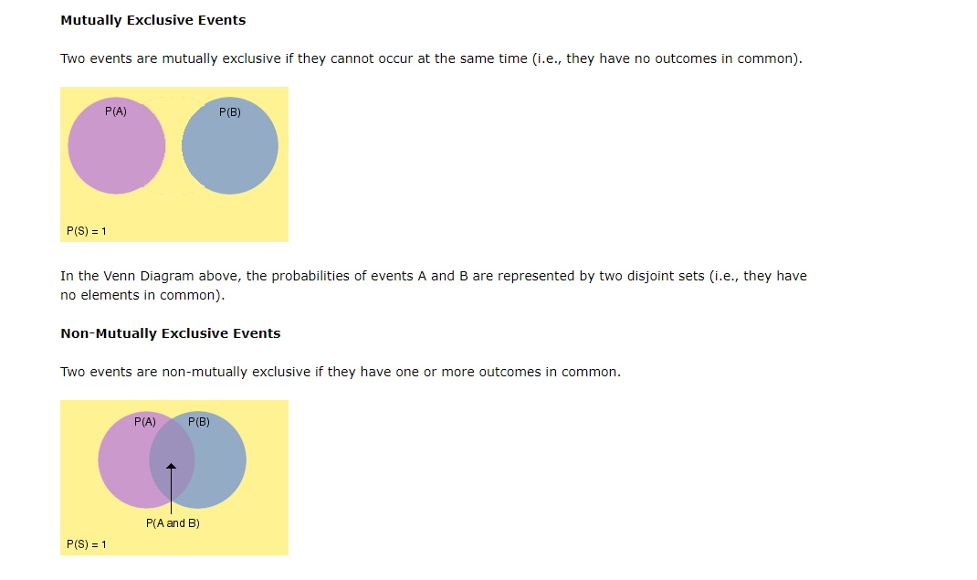
Mutually Exclusive Events

Slide 15
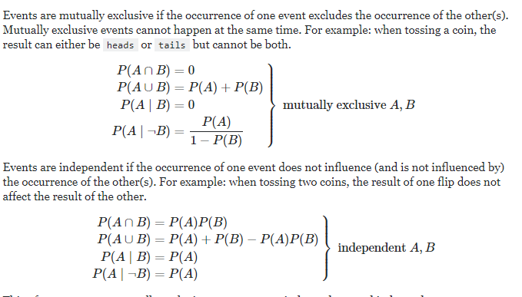
Mutual Exclusive & Independent Events Difference
Mutually exclusive events are not independent, and independent events cannot be mutually exclusive. (Events of measure zero excepted.)

Slide 16
Mutually Exclusive and Non Mutually Exclusive quiz
A single 6-sided die is rolled. What is the probability of rolling an odd number or an even number?
Possibilities:
1. The number rolled can be an odd number.
2. The number rolled can be an even number.
Check Answer
Mutually Exclusive
A single 6-sided die is rolled. What is the probability of rolling a 5 or an odd number?
Possibilities:
1. The number rolled can be a 5.
2. The number rolled can be an odd number (1, 3 or 5).
3. The number rolled can be a 5 and odd.
Not Mutually Exclusive

Slide 17
Mutually Exclusive and Non Mutually Exclusive quiz
A single letter is chosen at random from the word SCHOOL. What is the probability of choosing an O or a vowel?
Possibilities:
1. The letter chosen can be an O
2. The letter chosen can be a vowel
3. The letter chosen can be an O and a vowel
Not Mutually Exclusive
A single letter is chosen at random from the word SCHOOL. What is the probability of choosing an S or an O?
Possibilities:
1. The letter chosen can be an S
2. The letter chosen can be an O
Check Answer
Mutually Exclusive
Notes:
https://www.mathgoodies.com/lessons/vol6/mutually_exclusive

Slide 18
More Excercie

Slide 19
Conditional Probability
https://www.mathgoodies.com/lessons/vol6/practice_unit6

Slide 20
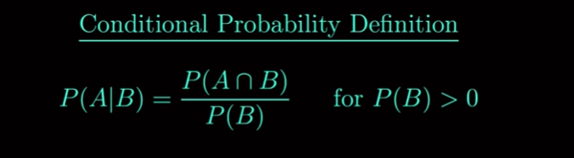
Conditional Probability

Slide 21



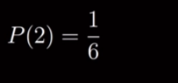
Conditional Probability

Slide 22
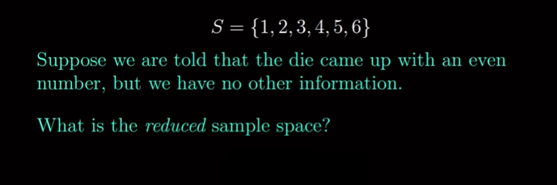
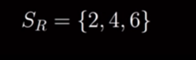

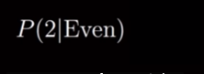
Conditional Probability
Notation; This is Assumed to be True.

Slide 23
Conditional Probability
Notation; This is Assumed to be True.
Answer is = 1/3 By Normal methodology

Slide 24
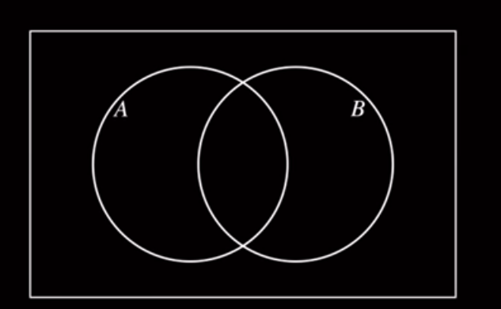
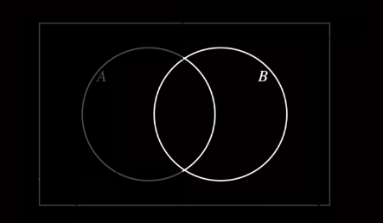
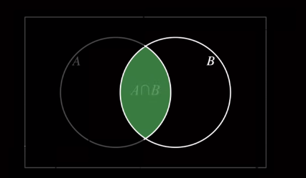
Conditional Probability

Slide 25

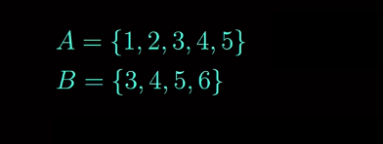
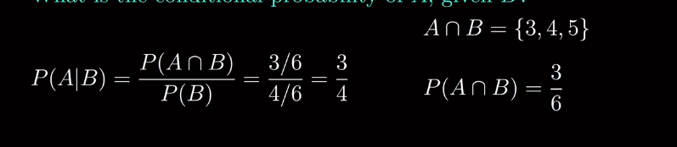
Conditional Probability – Example for deep understanding
Hint: Apply Reduce Sample Space

Slide 26
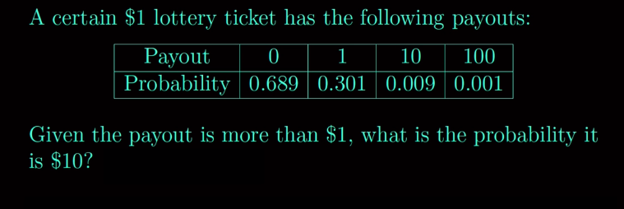
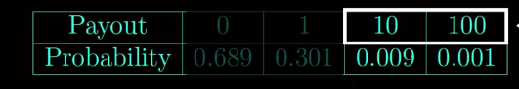
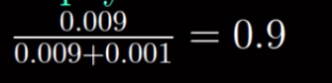
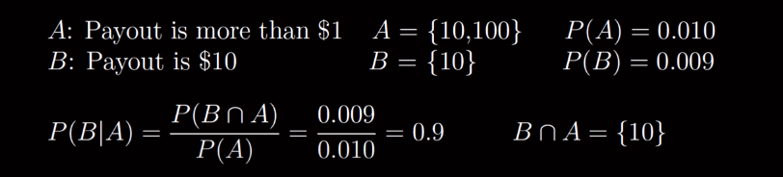
For Solving
Find Reduced Sample Space
Answer

Slide 27
Marginal Probability
Notes:
https://www.mathgoodies.com/lessons/vol6/mutually_exclusive

Slide 28
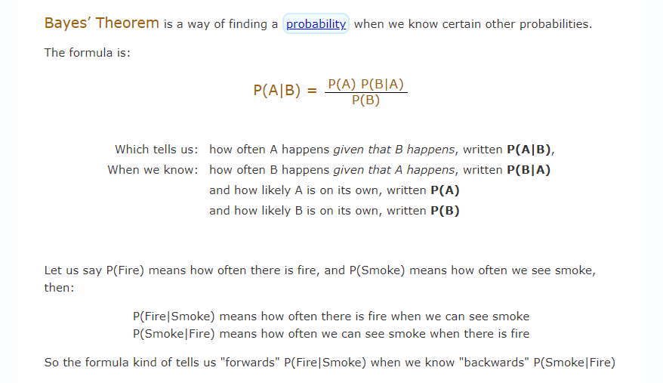
Bayes’ Theorem - Probability
Let us derive the formula from conditional probabilty
Notes:
https://www.mathgoodies.com/lessons/vol6/mutually_exclusive

Slide 29
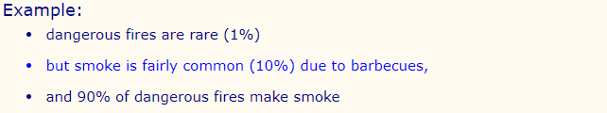

Bayes’ Theorem - Probability
Notes:
https://www.mathgoodies.com/lessons/vol6/mutually_exclusive

Slide 30
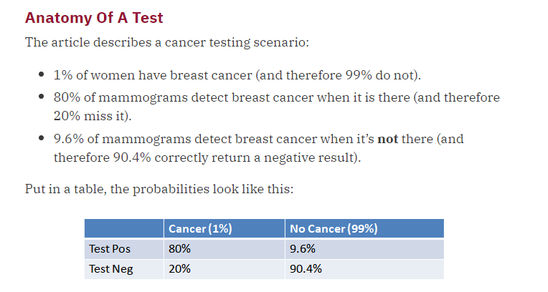
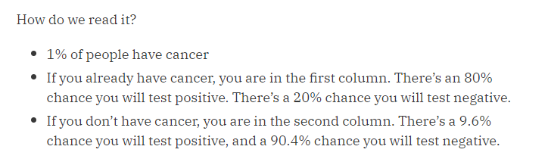
Bayes’ theorem converts the results from your test into the real probability of the event. For example,
Relate the actual probability to the measured test probability.
Given mammogram test results and known error rates, you can predict the actual chance of having cancer given a positive test.
Prior Probability

Slide 31
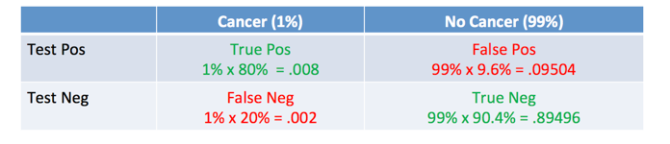
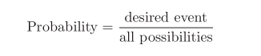
Contingency Table - Joint probability and apply marginal probability
Our Normal Way
How Accurate Is The Test?
Chance of Cancer is
0.008 / (.008 +.09504) = .0776

Slide 32
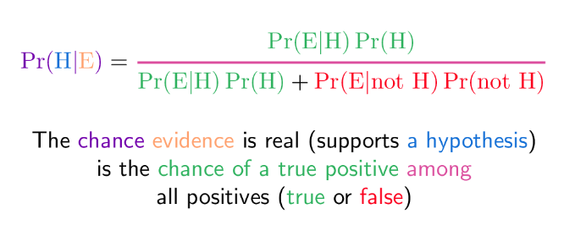
BAYES’ Method

Slide 33
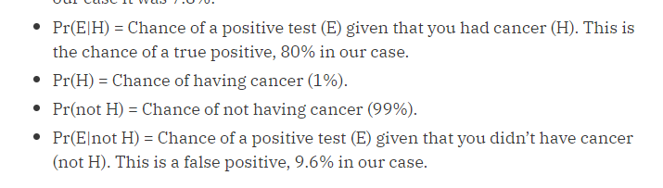
BAYES’ Method
= .008 / (.008 +.09504)
= .7.76

Slide 34
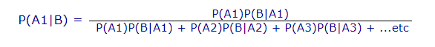

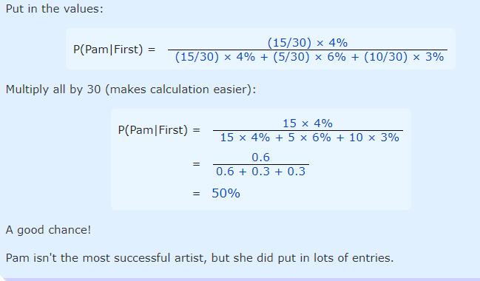
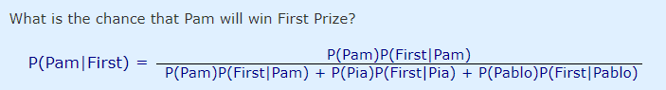
Bayes’ Theorem – Probability With Three (or More) Cases.
Notes:
https://www.mathgoodies.com/lessons/vol6/mutually_exclusive

Slide 35
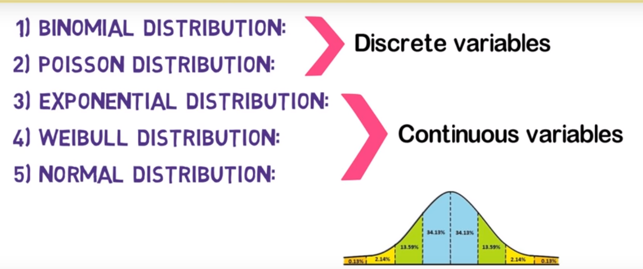
Different Types of Distribution With Three (or More) Cases.
Notes:
https://www.mathgoodies.com/lessons/vol6/mutually_exclusive

Slide 36
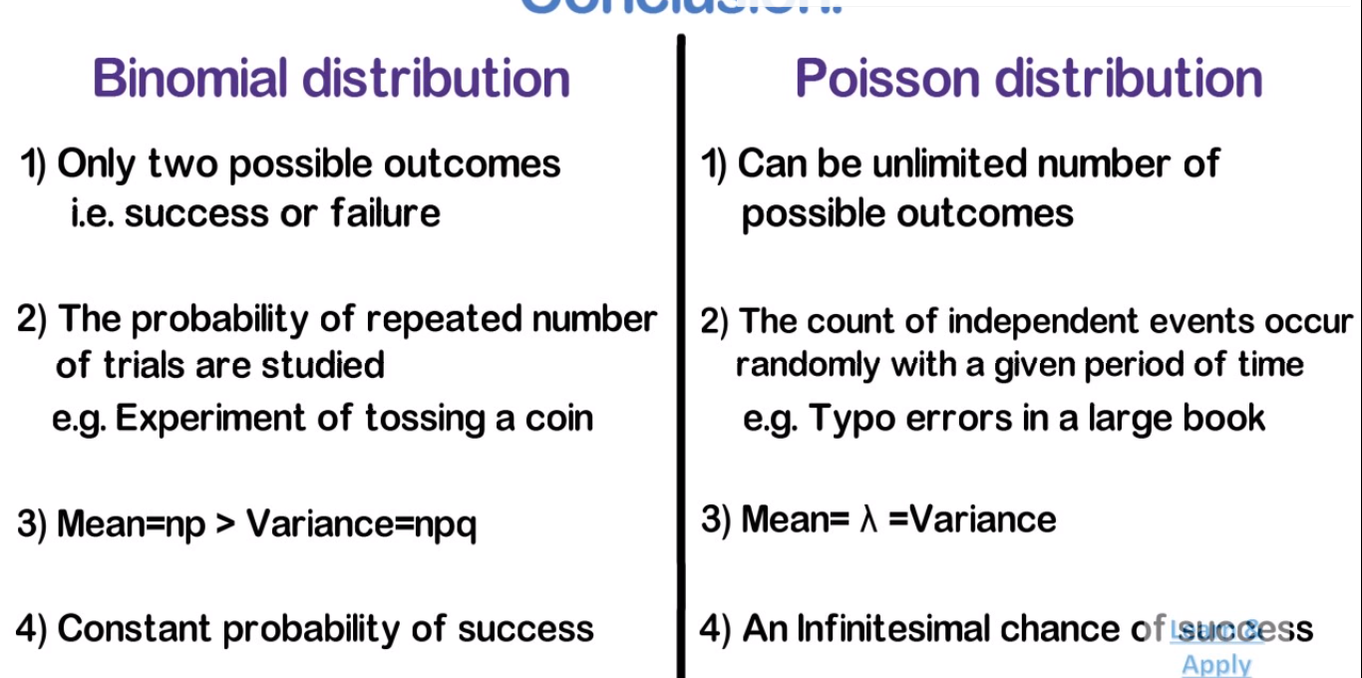
of success

